Slide 1
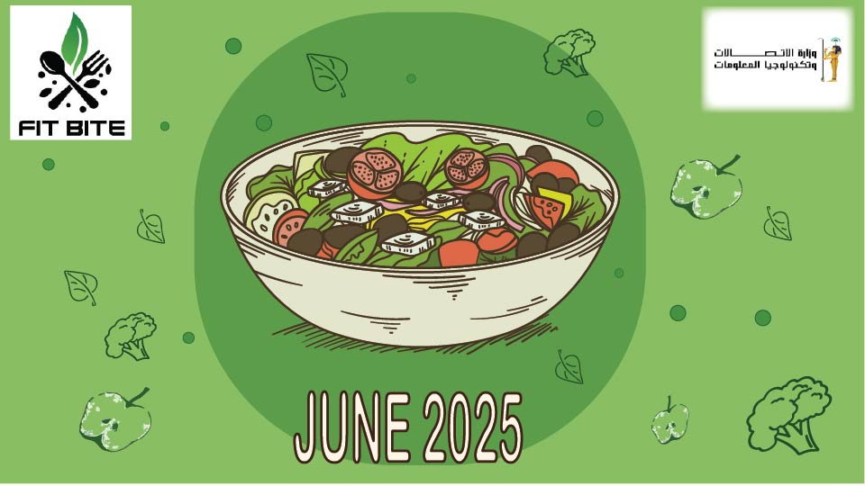

Slide 2
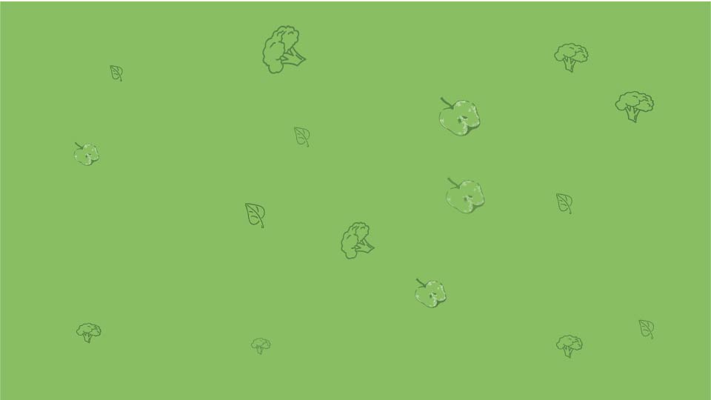
Group information
Company overview
Project planning and management
Literature review
Requirment gathering
System analysis and designing
Implemntation

Slide 3
A) Group information
Rinal Yasser Hafiz
Kareem Haggag
Salasabeel
Shahd Mahmoud qenawi

Slide 4
B) Restaurant overview
We are a health-focused restaurant offering a diverse range of nutritious meals tailored to modern lifestyles. Our menu features five specialized sections: Keto, Mediterranean, Low Carb, Vegan, and Paleo. Each dish is crafted with high-quality, fresh ingredients to support balanced eating without compromising on taste. We aim to make healthy eating simple, accessible, and delicious for everyone

Slide 5
C) LITERATURE REVIEW
Graphic design plays a vital role in shaping the identity and success of healthy restaurants. Several studies highlight the impact of visual branding on consumer perception. Colors such as green and blue are strongly associated with freshness, health, and nature, while clean and minimal typography reflects simplicity and trustworthiness.
Research on user experience in restaurants also emphasizes the importance of clear and well-structured menus. A visually organized menu not only improves readability but also influences customers’ food choices, encouraging them to select healthier options without feeling restricted.
In addition, market analysis shows that the healthy food sector is highly competitive, as many restaurants offer similar meals (salads, smoothies, low-carb dishes). Therefore, a unique and consistent visual identity becomes the key differentiator. Strong branding across both offline and online platforms helps build recognition, attract customers, and communicate the restaurant’s core values effectively.

Slide 6
D) Requirment gathering
1 Introduction and System Goals
Since the restaurant focuses on providing healthy and balanced meals that fit modern lifestyles, it is essential to design a system that manages orders efficiently, enhances the customer experience, and provides the management with accurate reports for decision-making. The main goal of the system is to make healthy eating not only a choice but also an easy, enjoyable, and secure experience for everyone.
2 Users
1. Customer: Browse the healthy menu, place orders, complete payments, and track order status. 2. Cashier: Handle customer orders, generate invoices, and manage payments. 3. Chef: Receive order details, prepare meals, and update order status. 4. Manager: Oversee the menu, review sales reports, and analyze performance.
3 Functional Requirements
Customer registration and login. Browse menu by dietary category (Keto, Mediterranean, Low-Carb, Vegetarian, Paleo). Create and track orders. Add/remove items from the shopping cart. Support multiple payment methods (cash, card, e-payment). Generate and store invoices.

Slide 7
D) Requirment gathering
4 Non-Functional Requirements
Usability: Simple and user-friendly interface. Performance: Fast browsing and order processing. Security: Protection of customer data and transactions. Scalability: Ability to handle increasing numbers of customers and orders. .

Slide 8
D) System Analysis & Data design
3 Data Flow
1. Customer browses the menu and selects meals. 2. Order is sent to the cashier, then to the chef for preparation. 3. Chef updates the order status once completed. 4. Customer completes payment. 5. Manager reviews data through reports and analytics.
1 Use Cases Customer:
Register/Login – Browse Menu – Place Order – Make Payment – Track Order. Cashier: Confirm orders – Generate invoices – Update payment status. Chef: View orders – Update preparation status. Manager: Manage menu – View reports – Analyze sales data.
2 Database Design (ERD) Customers: (CustomerID, Name, Phone, Email, DietType).
MenuItems: (ItemID, Name, Category, Price, Calories). Orders: (OrderID, CustomerID, Date, TotalAmount, Status). OrderDetails: (OrderDetailID, OrderID, ItemID, Quantity).
Payments: (PaymentID, OrderID, Method, Status, Date).

Slide 9
E) Implemntation
1. Brand Identity Development
Design a simple and modern logo that reflects health and energy.
Establish a color palette (green, white, with a touch of orange) to symbolize freshness and vitality.
Select suitable typography that conveys clarity and modernity.
2. Visual Marketing Materials
Create social media templates for Instagram and Facebook to ensure brand consistency.
Design both digital and printed menus that are easy to navigate and highlight meal categories (Mediterranean, Low-carb, Vegan).
Develop posters, flyers, and banners to communicate key brand messages such as “Healthy,” “Fresh,” and “Lifestyle-oriented.”
3. Digital Experience
Design a user-friendly website/app interface for online ordering.
Use high-quality food photography enhanced with clean design layouts to showcase dishes.
4. Continuous Improvement
Collect customer feedback and update the brand visuals regularly to remain relevant and competitive.

